Slide 1
Chapter Four
Mutual Funds and Other Investment Companies

Slide 2
Chapter Overview
Types of Investment Companies
Mutual funds:
  Functions
  Investment styles and policies
  Investment costs
  Performance
  Sources of information

Slide 3
Investment Companies
(1 of 2)
Pool funds of individual investors and invest in a wide range of securities or other assets
Services provided:
  Record keeping and administration
  Diversification and divisibility
  Professional management
  Lower transaction costs

Slide 4
Investment Companies
(2 of 2)
Investment Companies
Unit Investment Trusts
Managed Investment Companies
Other Investment Organizations

Slide 5
Net Asset Value
Net Asset Value (NAV):
Calculation:
Notes:
Net Asset Value (NAV): is the value of each share in the investment company

Slide 6
Investment Companies:
Unit Investment Trusts
Investment Companies
Unit Investment Trusts
Managed Investment Companies
Other Investment Organizations
  Fixed portfolio of uniform assets
  Unmanaged
  Declined from $105 billion (1990) to $94 billion (2016)

Slide 7
Investment Companies:
Managed Investment Companies
Investment Companies
Unit Investment Trusts
Managed Investment Companies
Other Investment Organizations
Open-End
Closed-End
Open-End
  Issues shares when investors buy; redeems shares when investors cash out
  Priced at Net Asset Value (NAV)
Closed-End
  Shares outstanding constant; investors cash out by selling to new investors
  Priced at premium or discount to NAV
Notes:
Think: Why might a Closed-End Fund be priced at a premium or discount to NAV?

Slide 8
Investment Companies:
Other Investment Organizations
Investment Companies
Unit Investment Trusts
Managed Investment Companies
Other Investment Organizations
Commingled Funds
REITs
Hedge Funds
Commingled funds:
REITs:
Hedge Funds :
Notes:
Commingled funds: partnerships of investors that pool funds.
REITS: A Real Estate Investment Trust (REIT) is similar to a closed-end fund. REITs invest in real estate or loans secured by real estate. Most of them are highly leveraged, with a typical debt ratio of 70%.
Hedge Funds: Commonly structured as private partnerships (and thus subject to only minimal SEC regulation), hedge funds allow private investors to pool assets to be invested by a fund manager.

Slide 9
Mutual Funds
Investment Companies
Unit Investment Trusts
Managed Investment Companies
Other Investment Organizations
Open-End
a.k.a. Mutual Funds
Closed-End
Money Market
Equity
Sector
Bond
International
Balanced and Fund of Funds
Asset Allocation and Flexible
Index

Slide 10
Mutual Funds: Investment Policies
(1 of 2)
Money Market:
Equity:
Sector:
Bond:
Notes:
Money Market: These funds invest in money market securities such as commercial paper, repurchase agreements, or certificates of deposit
Equity: Equity funds invest primarily in stock
Sector: Equity funds that concentrate on a particular industry.
Bond: Concentrate in the fixed-income sector.

Slide 11
Mutual Funds: Investment Policies
(2 of 2)
International:
Balanced:
Fund of Funds:
Asset Allocation:
Index:
Notes:
International Funds:
Global funds invest in securities worldwide, including the United States
International funds invest in securities of firms located outside the United States
Regional funds concentrate on a particular part of the world
Emerging market funds invest in companies of developing nations
Balanced Funds:
Life-cycle funds are balanced funds in which the asset mix can range from aggressive (primarily marketed to younger investors) to conservative (directed at older investors)
Targeted-maturity funds gradually become more conservative as the investor ages
Funds of funds: Mutual funds that primarily invest in shares of other mutual funds.
Asset Allocation: May dramatically vary the proportions allocated to each market in accord with the portfolio manager’s forecast of the relative performance of each sector
Index: Tries to match the performance of a broad market index

Slide 12
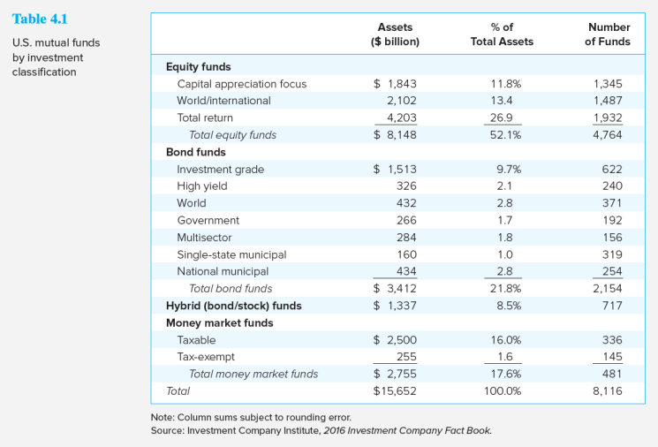
U.S. Mutual Funds by
Investment Classification

Slide 13
Mutual Funds: How Funds Are Sold
How Funds Are Sold
  Direct-marketed funds
  Sales-force distributed
    Revenue sharing on sales force distributed
    Potential conflicts of interest
  Financial supermarkets

Slide 14
Costs of Investing in Mutual Funds
Fee Structure:
  Operating expenses
  Front-end load
  Back-end load
  12 b-1 charge
Fees must be disclosed in the prospectus
  Share classes with different fee combinations

Slide 15
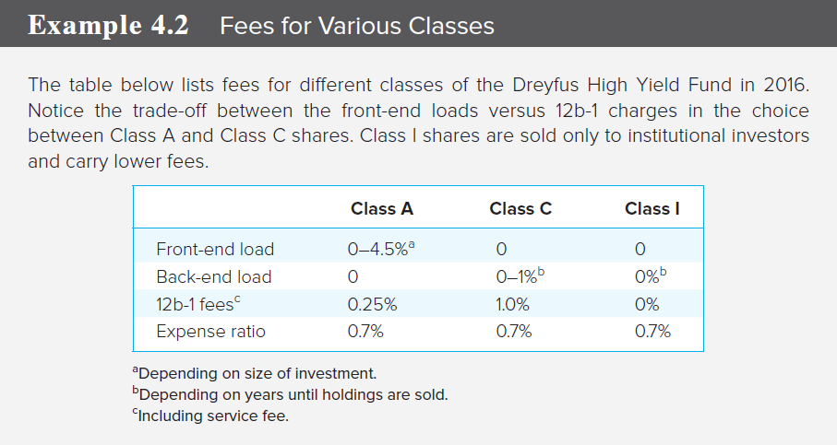
Fees for Various Classes

Slide 16
Fees and Mutual Fund Returns
Example:
  Initial NAV = $20
  Income distributions of $.15
  Capital gain distributions of $.05
  Ending NAV = $20.10

Slide 17
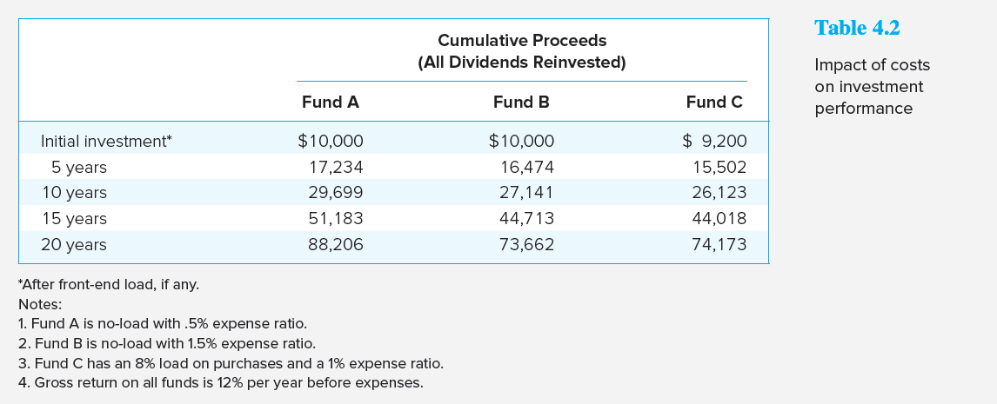
Impacts of Costs on
Investment Performance

Slide 18
Taxation of Mutual Fund Income
Pass-through status under the U.S. tax code
  Taxes are paid only by the investor
  Fund investors do not control the timing of the sales of securities from the portfolio
High portfolio turnover leads to tax inefficiency
  Average turnover = 50%

Slide 19
Exchange Traded Funds
Examples: “spiders,” “diamonds,” and “cubes”
Potential advantages:
  Trade continuously like stocks
  Can be sold short or purchased on margin
  Lower costs
  Tax efficient
Potential disadvantages:
  Prices can depart from NAV
  Must be purchased from a broker

Slide 20
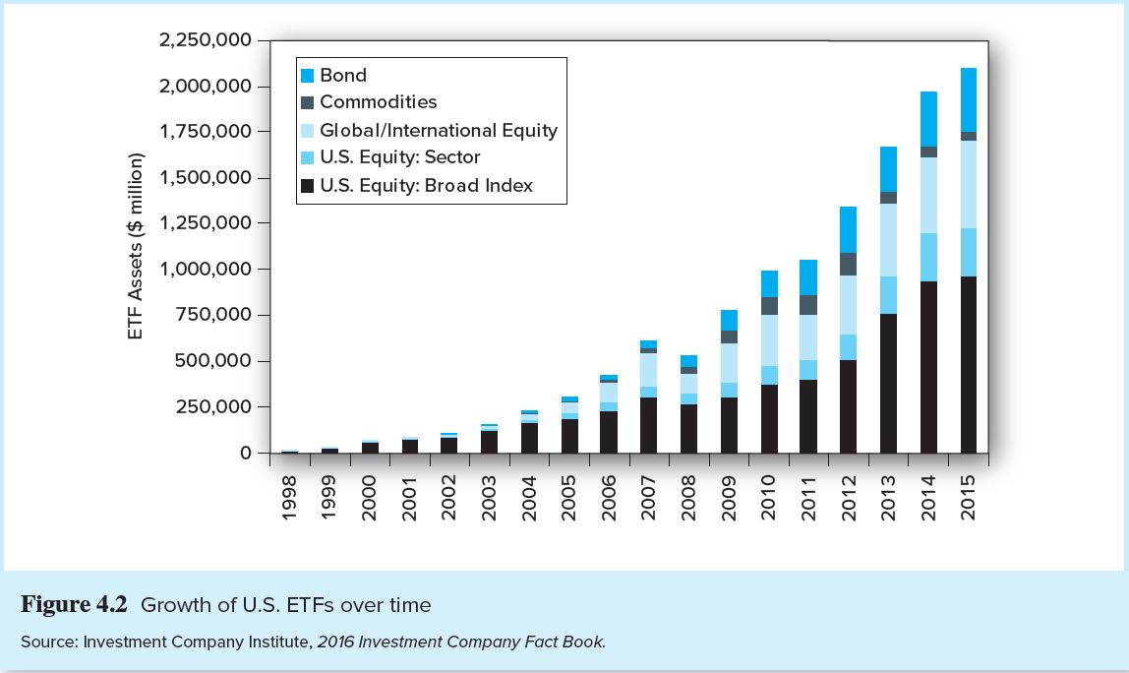
Growth of U.S. ETFs over Time

Slide 21
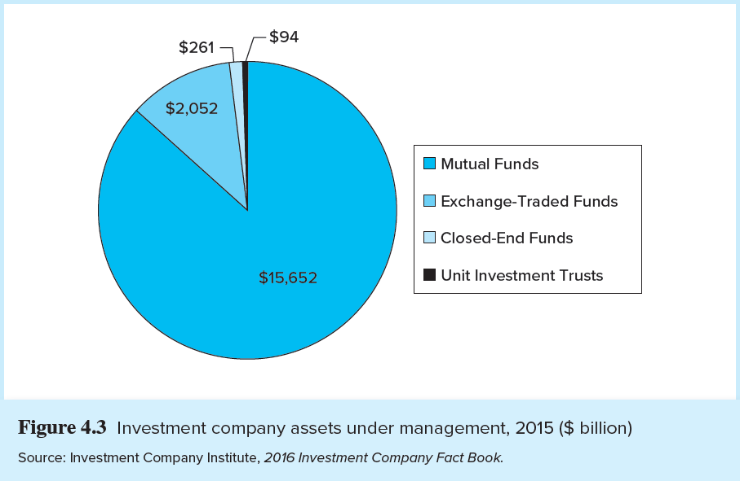
Investment Company Assets Under Management, 2015 ($ Billion)

Slide 22
Mutual Fund Investment Performance
Performance of actively managed funds:
  Lagged Wilshire index in 27 of the 45 years (1971-2015)
  Evidence for persistent superior performance is weak, but suggestive
  Bad performance is more likely to persist

Slide 23
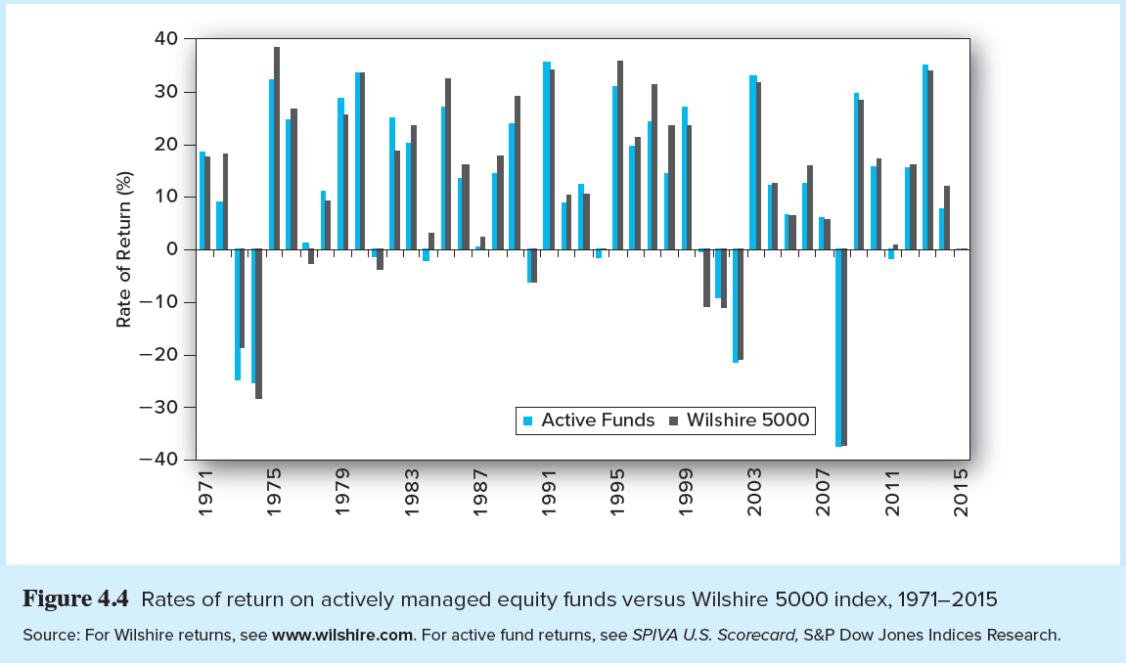
Diversified Equity Funds versus Wilshire 5000 Index

Slide 24
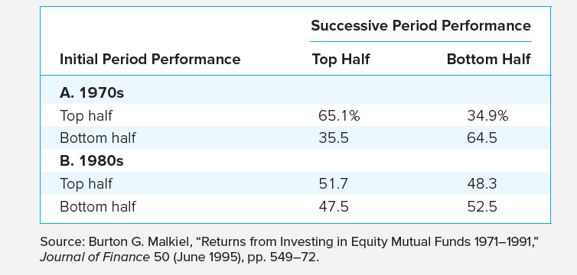
Consistency of
Investment Results

Slide 25
Information on Mutual Funds
(1 of 2)
Fund’s prospectus describes:
  Investment objectives
  Fund investment adviser and portfolio manager
  Fees and costs
Statement of Additional Information (SAI)
Fund’s annual report

Slide 26
Information on Mutual Funds
(2 of 2)
Morningstar
Yahoo
Investment Company Institute
Directory of Mutual Funds

